Slide 1
Custom Legal Advisor
Project S20-37
Advisors: Professor Marsic, Gu Yue
Team Members: Andrew Sengupta, Amandip Kaler, Jeff Lu, Aditya Mehta

Slide 2
Background Information
Laws protect our safety and ensures our rights, however, not even an experienced lawyer can recite most of the U.S. Code. And for us average citizens, legal knowledge distances itself right at the time we need it the most.
The objective of this project is to create an intelligent research tool that employs natural language processing to search relevant United States code from the given brief of a case. This would make it much simpler for the average citizen to be able to simply look up a law and what it entails.
Notes:
Project abstract
The purpose of this project
The problem we are dealing with
How we are planning to deal with it

Slide 3
Original Idea About the Project
Our idea is a service providing website that can provide legal advices to any visitors based on their scenarios. By employing natural language processing, the AI will interpret the case provided by the visitor, then it will browse the US code to look for applicable laws relating to the case.
We envisioned a website that acts as a virtual lawyer, in which the visitors can ask questions and the AI will provide customized answers. The site should understand the questions and dig for appropriate laws, then highlight important(relevant) part and rephrase the laws to the asking.
Notes:
General intro

Slide 4
Project Stages
Stage I -- Preparation: Gather legal case data for NLP training
Stage II -- Foundation: Build and website UI, train basic NLP model
Stage III -- Prototype: Connect database, Trained AI and website, create a functional legal research tool
Stage IV -- Interactive Stage: Expand on the basic framework by making the website interactive
Stage V -- AI Enhancement: Improve AI performance with more data and better NLP model
Notes:
Stages in terms of purpose, in our vision, the custom legal advisor has 5 stages
Stage 1,

Slide 5
Project Scope of Work
The idea consists of five stages, is impossible to complete within one semester. Our scope of work ends at stage III, we call it the prototype stage. In this stage we should build a basic framework for our idea that can easily be expanded in the future.
The end product of our group, as stated in the introduction, is an intelligent search tool -- without interactive features and with a backend model that will need future improvements.
Notes:
//until stage 3

Slide 6
Work Plan
Research and data gathering
Completed before February
Building of Web application + Training (and testing) of NLP model
Happening in parallel between February and mid March
Integration of interface and backend
After second stage is completed in late March
Examine direction for future improvement
Alongside the final report through May
Note: this was the plan before COVID-19 outbreak
Notes:
The original work plan

Slide 7
Project Design

Slide 8
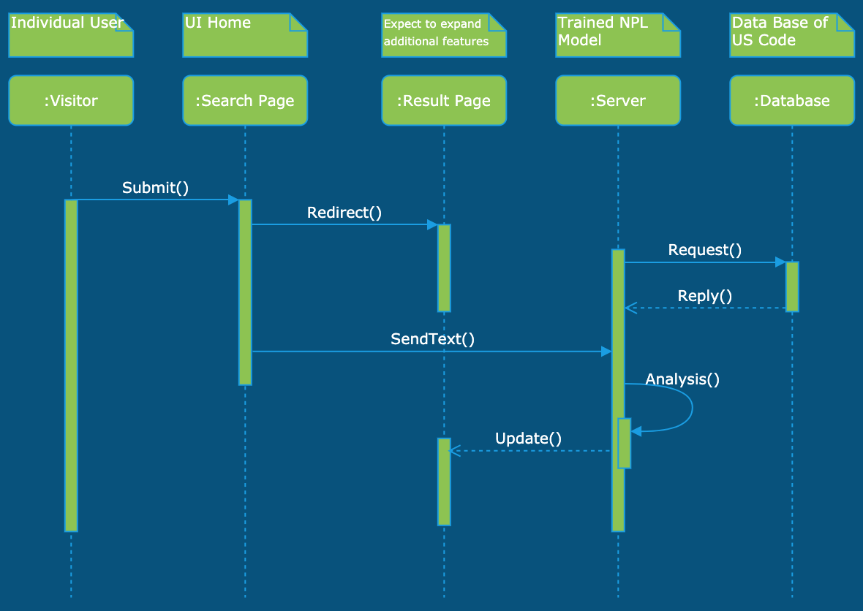
Project Design
This web-app does text analysis with a trained NLP model in the server, the server then requests appropriate law from database and provide legal advice to the customer.
Notes:
//this is the seq. Diag. for our “search” use case

Slide 9
Project Design (Cont.)
For the prototype stage of this project (the search tool), we employed Natural language processing to analyze legal questions posted by site visitors (customers). The prototype allows user upload a or copy a text document to the website input page; the text will be sent to server, which the analysis with the pretrained model, first highlights key words from the case, then search the database for applicable laws; the results are returned to the visitor in a result page.
Notes:
Additional detailed design
This is a simple design… I really don’t know what more to talk about...

Slide 10
NLP Implementation
For this project we chose PyTorch for the implementation of Natural Language Processing: we had experience with pytorch face recognition in an earlier project and PyTorch itself has a very good NLP library.
We ultimately decided to use a simple deep learning model, a recurrent neural network (RNN). The disadvantage of RNN is that it’s behavior is chaotic and a simple model cannot remotely achieve NLP. It is enough for our purpose with this project however, because to improve upon NLP model is one branch of future development.
Notes:
NPL model

Slide 11
Future of the Project

Slide 12
Future of the Project
Our group aimed to create a framework that can be improved further, so future improvements are most desired.
After completing the prototype, a basic improvement would be creating a more interactive experience: instead of search only, the interactive version of the website can also ask more specific questions regarding legal cases provided by the visitor, and give additional feedbacks accordingly.
As deep learning technologies improves, there should also be major improvements made to the NLP model, perhaps one day an intelligent AI be able to pick up more emotions behind words.
Notes:
Expanding on scope of work, what is beyond original proposal

Slide 13
April 2020
Stay healthy

